Slide 1




BAJA SAE INDIA 2013 Virtuals Presentation
The Road Runners
Team ID : 91636
VIT University, Chennai

Slide 2
Outline
Design review
Design validation plan
Project plan

Slide 3
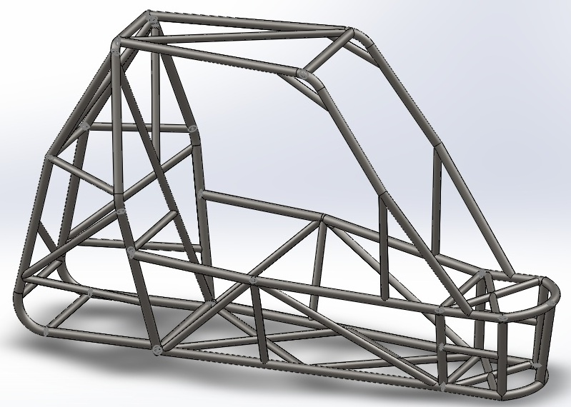
ROLLCAGE

Slide 4
Material selection

Slide 5
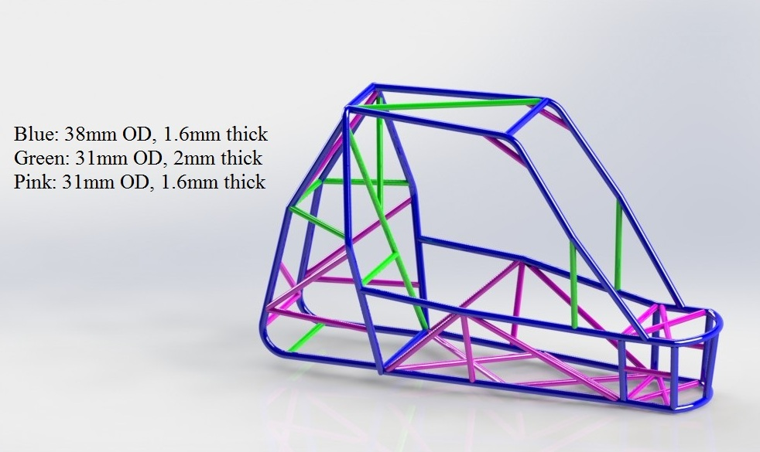
Selection of dimensions for optimizing strength to weight ratio

Slide 6
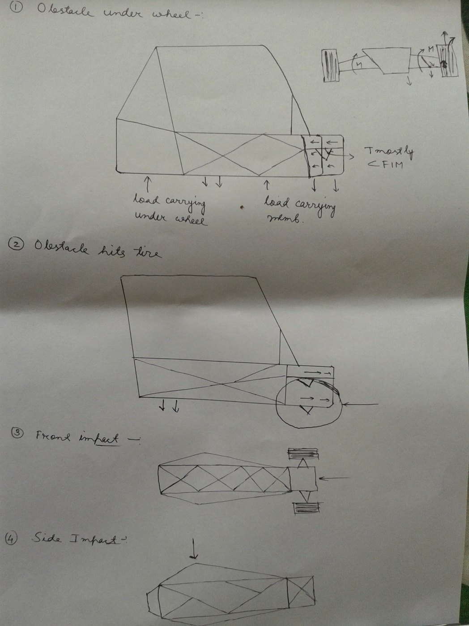
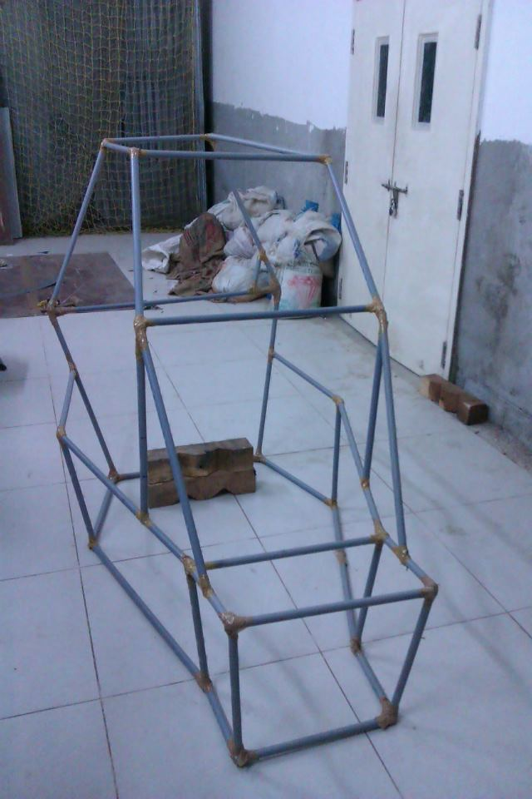
Design Methodology

Slide 7
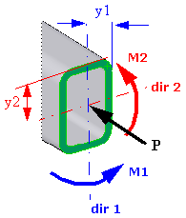
FEA using SolidWorks Simulation
Upper bound axial and bending: The software calculates the highest stresses at the extreme fibers of the cross-section, by combing the uniform axial stress and the two bending stresses due to M1 and M2 This is the recommended stress to view. The stress values are calculated at both ends of each mesh element:
P/ A + [(M₁* I₂₂ + M₂ * I₁₂) * y₁ + ( M₂ * I₁₁ + M₁ * I₂₁) * y₂)] / (I₂₂ * I₁₁ - I₁₂^²)

Slide 8
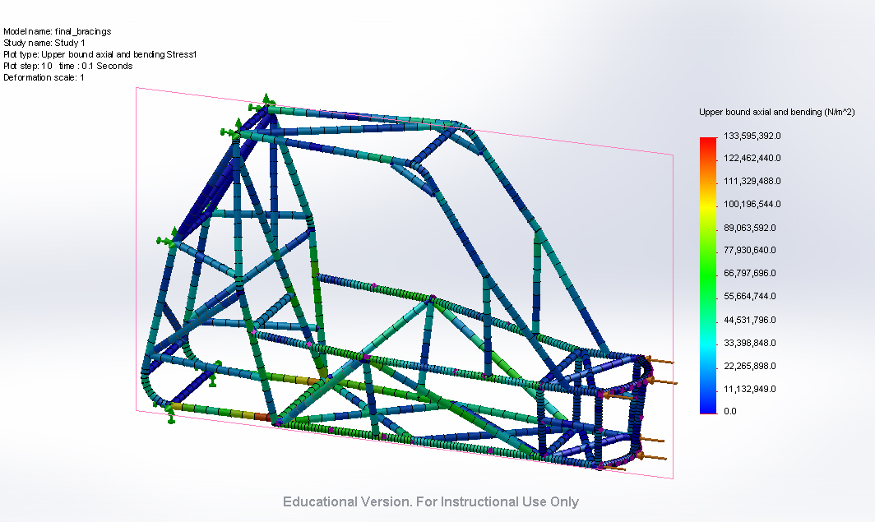
Front Impact Test At 7.9g net force = 27097N,
Time = 100ms, MSE= 133.5 MPa , δ= 1.9mm

Slide 9
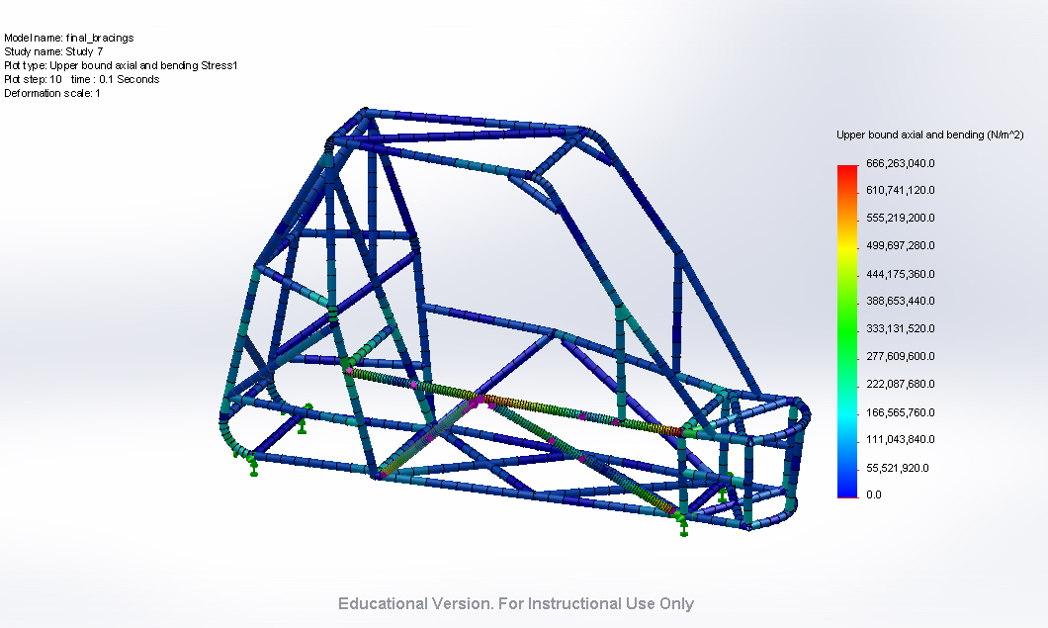
Side Impact Test At 3.75g net force = 12862.5N,
Time = 100ms, MSE= 666.2 MPa , δ= 10.57mm

Slide 10
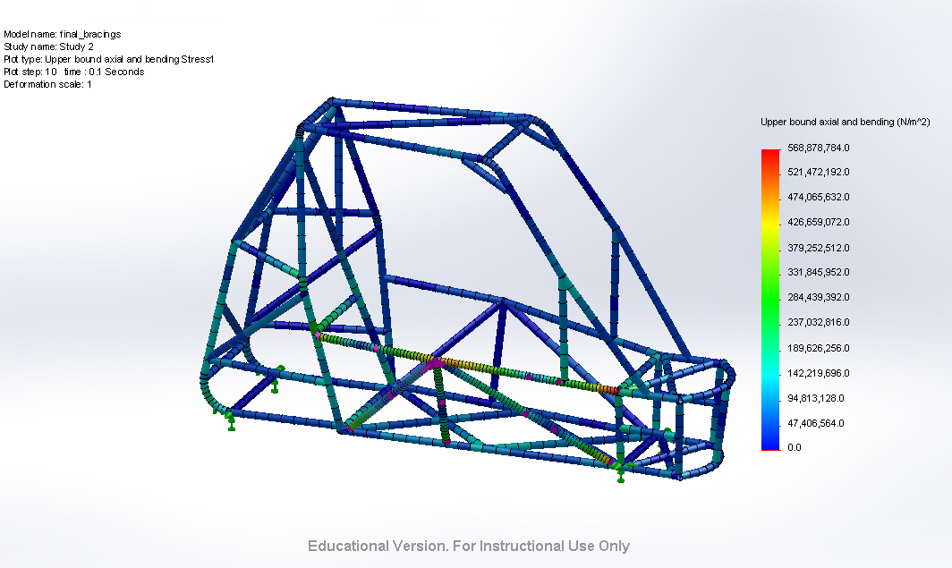
Side Impact Test At 3.75g net force = 12862.5N,
Time = 100ms, MSE= 568.6 MPa , δ= 10.38mm

Slide 11
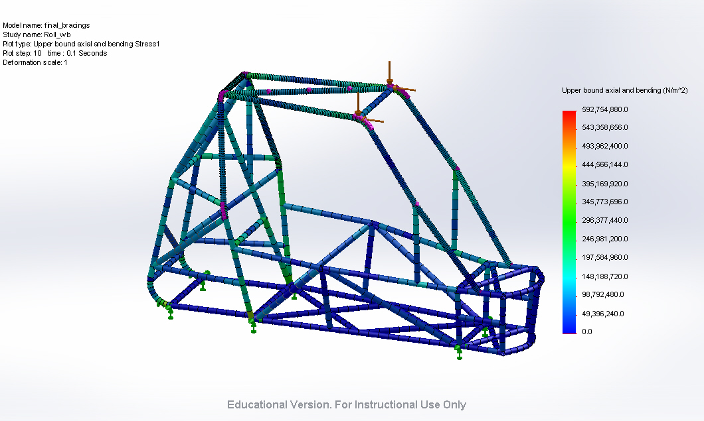
Roll Over Test At 3.75g net force = 12862.5N,
Time = 100ms, MSE= 592.7 MPa , δ= 10.94mm

Slide 12
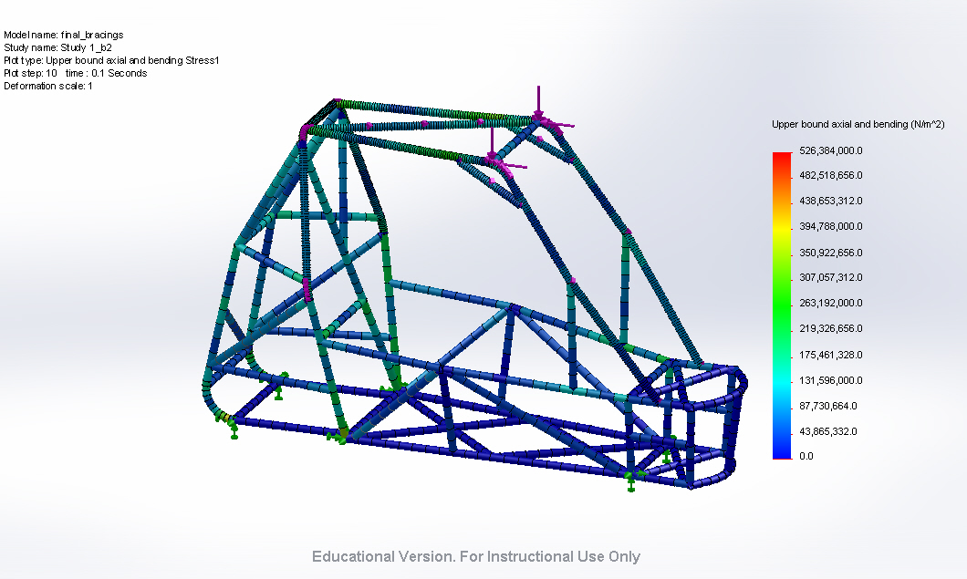
Roll Over Test At 3.75g net force = 12862.5N,
Time = 100ms, MSE= 526.3 MPa , δ= 9.13mm

Slide 13
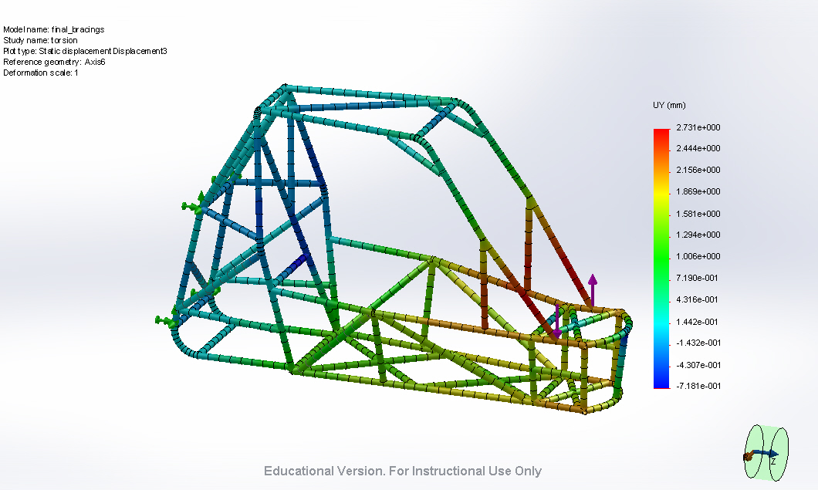
Torsion Test net force = 6000N,
Torsional rigidity= 2234.25Nm/deg, δy= 2.71mm

Slide 14
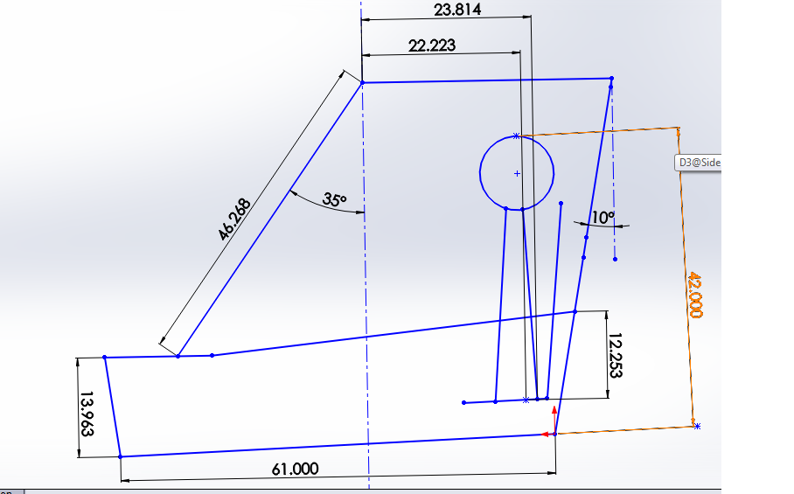
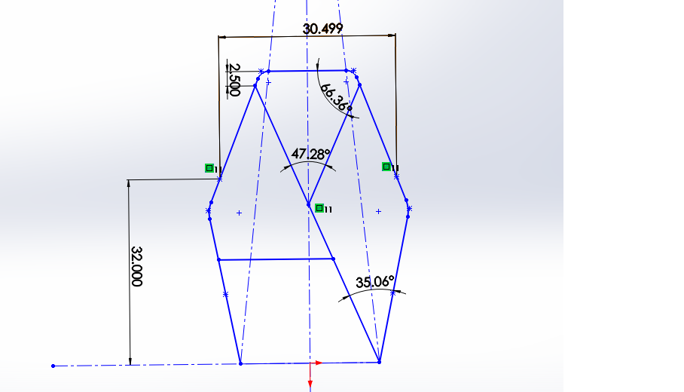
Compliance with rulebook

Slide 15
Ergonomic design
Best elbow angle for exerting force in the seated position is approximately 120°
For heavy loads, 7”-20” wheel. Ours:12”
The leg exerts maximum force with the knee angle at about 130-150°.
Below thighs, storage compartment.
Good frontal view with wide gap in FIM

Slide 16
SUSPENSION

Slide 17
DFMEA
Potential Failure | Potential Effect | Potential Cause | Current Process Control
Upright | vehicle immobile | impact loading, fatigue | FEA analysis
Upper and Lower arm | vehicle immobile | torsion and impact bending | FEA analysis
Ball and socket joints | vehicle immobile | excessive unidirectional load | OEMs
Brackets | vehicle immobile | excessive load due to single wheel landing | Superior material
Leakage in damper | damping decreases | Crack due to impact | Good quality customised shocks

Slide 18
Suspension System
Front suspension : Double A arm type
Rear suspension : Mcpherson type
Ground clearance : 280 mm
Roll Centre : 90 mm (front), 330 mm(rear)
Wheel travel
 | Wheel travel (mm) | Jounce (mm) | Rebound (mm)
Front | 356 | 204 | 152
Rear | 255 | 152 | 103

Slide 19
Front Suspension System
Total wheel travel : 356 mm
Corner sprung weight: 68 Kg
Corner unsprung weight: 9 Kg
Droop percentage: 42%
Camber Angle: -2 deg.
Description | Values
Motion Ratio | 0.63
Ride frequency | 1.29 Hz
Scrub radius | 25.4 mm
Spring rate | 11380 N/m
For Dual spring Main Spring Rate
Tender spring

Slide 20
Rear Suspension System
Total wheel travel: 254 mm
Corner sprung weight: 91Kg
Corner un-sprung weight: 18.5Kg
Droop percentage: 40%
Camber Angle: 0 deg.
Description | Values
Motion Ratio | 1
Ride frequency | 1.57 Hz
Scrub radius
Spring rate | 7900 N/m
For Dual spring Main Spring Rate
Tender spring

Slide 21
Design Methodology
Roll center calculation and graphical representation.
Upright design according to given specifications from steering and brakes department.
FEA analysis on uprights and double A arms.
Selection of shocks (piggyback fully adjustable coil over shocks 2.5”)

Slide 22
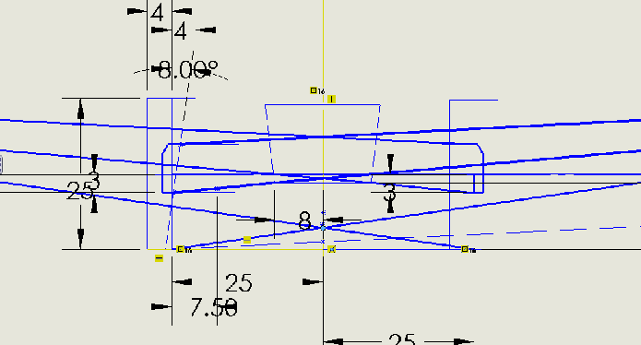
Roll Center Height

Slide 23
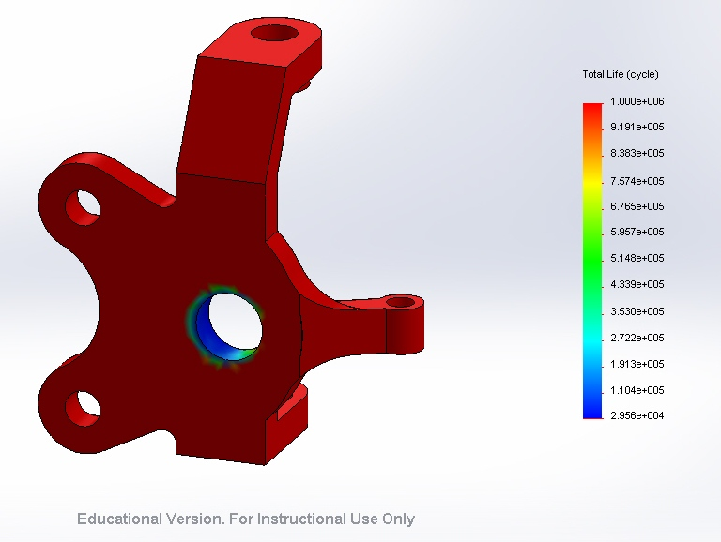
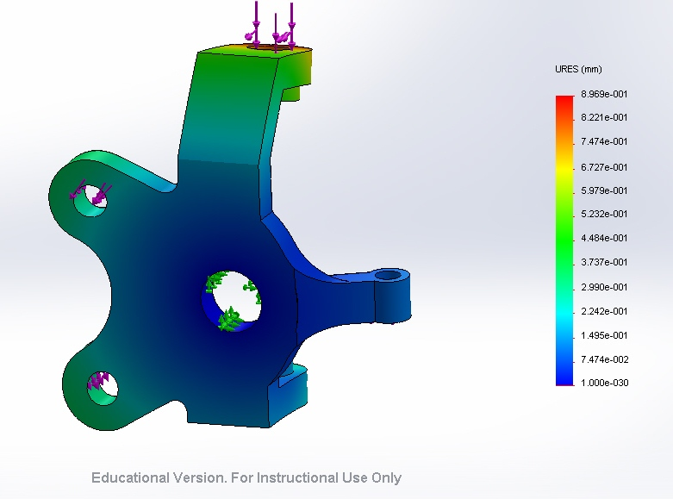
FEA analysis of front upright

Slide 24
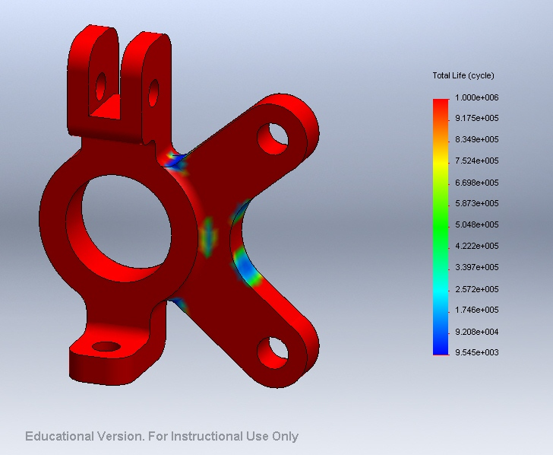
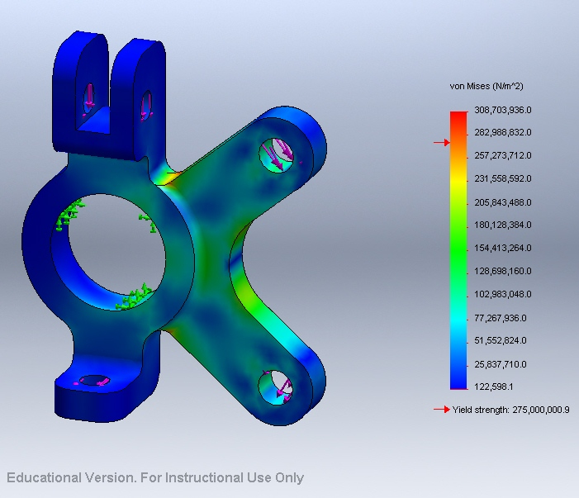
FEA analysis of rear upright

Slide 25
BRAKES

Slide 26
DFMEA
Sl No | Failure | Cause | Effect | Chance of Occurance
1 | Wearing of brake Pads | Reduction in brake pads dimension | Tremendous loss in Braking power | After a long period of time around 2 or 3 years
2 | Less effective Braking force | Reduced amount of braking fluid in braking lines | Affects braking force | Only when the brake lines get deformed in case of accidents
3 | Brake Shudder | Wrapped brake rotors; 1. Improper brake pad material. 2. Driving style. 3. Binding brake calipers. | Shaking steering wheel, lost of control when brakes are applied.
4 | Presure for normal secondary piston | Operated mechanically | Pressure difference | When not proper lubrication in master cylinder

Slide 27
Design
Front and rear Disc brakes
6:1 pedal ratio
Tandem Master cylinder
Diagonal Split system
60: 40 brake bias
Brake fluid- DOT 3 (polyethylene glycol-based fluid)
Electrical Parking Brake using solenoid valve

Slide 28
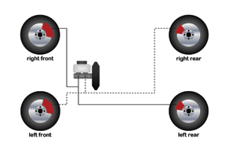
Diagonal split system

Slide 29
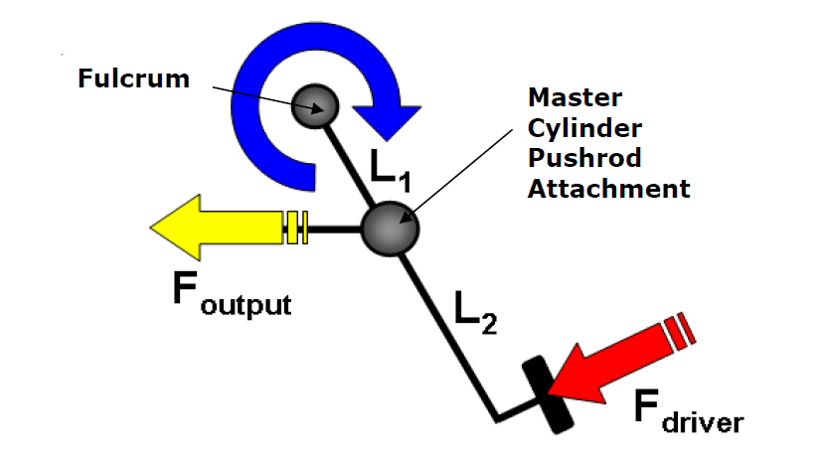
Design methodology
Braking Force calculation :
Required by vehicle for stopping
F=ma
Where,
m= mass of vehicle
a=0.6 g
g=9.81
Recheck on force calculations after the complete design(analysis of available OEM’s)
F= P*A
Where,
F = Braking force by each piston in caliper(total no of piston in each caliper =4)
P = Brake line pressure( in Pascal)
A= Calipers piston Area (in m^2)

Slide 30
Design methodology contd…
Stopping Distance calculations
where,
s= stopping Distance (in m)
u = initial velocity of vehicle = 45 km/hr = 12.5 m/s
v= final velocity of vehicle = o m/s
a= -0.6 g
g=9.81
Braking Torque
where,
= Torque developed due to braking action
r = rotor radius
F= Braking Force

Slide 31
Specifications
S.No | Parameter | Value
1 | Pedal Ratio | 6:1
2 | Tandem Master Cylinder bore diameter | 19.05 mm
3 | Brake line diameter | 9.525 mm
4 | Brake line pressure | 2.0644 M Pa
5 | Rotor diameter | 182.88 mm
6 | Braking Force | 2092.09384 N
7 | Braking Torque | 1991.301067 N--m
8 | Stopping Distance | 13.27 m

Slide 32
Innovation
Electronic Parking Brakes
Solenoid valve(Brake fluid control)
In ON state normal braking action
After brake pedal floored switch on control button
Valve closes & brake fluid locked in place
In front 2 wheels

Slide 33
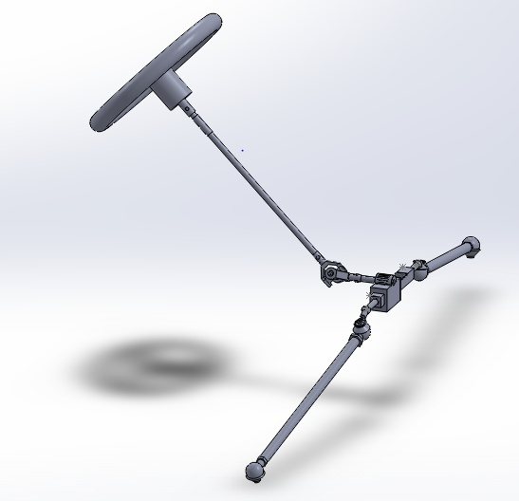
STEERING

Slide 34
DFMEA
Failure | Cause | Effect | Chance of occurrence
tie rod | fluctuating/variable loads | loss of steering | less depending upon material and stress induced
bearings | friction | steering wheel's movement is restricted | less depending upon material and bearing type
steering arm | bump steer | failure of steering system | less as effect is adjusted by geometry
joints | variable stress in different directions | failure of steering system | less depending on the quality of threads and quality of joints
rack | excessive use of pinion over it | undercutting in teeth and loss in precision of steering | depending on quality of product purchased and repetitive use

Slide 35
Design Methodology
Choice of steering system : central rack and pinion
Justification : economical for low loads, easily available
Choice of steering geometry : Ackermann (photo)
Justification : reduced wear rate of tyres , ease in manoeuvrability

Slide 36
Flow of Calculations
C-factor
Steering arm length
Steering ratio
Average steer angle
Ackermann angle

Slide 37
Specifications
PARAMETER | SPECIFICATION
Ackermann angle | 24 ⁰
Steering ratio | 6.1:1
Wheel turn angle | 30.65 ⁰
Steering arm length | 84.582 mm
Toe out | 3 ⁰
Turning radius | 3.87 m

Slide 38
POWER TRAIN

Slide 39
DFMEA
Design function | Potential failure | Potential effect | Potential cause | Current process control
power train | Drive shaft | Vehicle immobile | Sudden loading, torsion | FEA analysis
 | Gearbox failure | Gear shift will not be possible | Shift lever
 | Failure of engine mounts | vibrations | Over vibrations
 | Oil spills | Fire,hzardous for driver | Drip pan
 | Axle bending | Excessive vibrations | Eccentricity of centers of joint and shaft

Slide 40
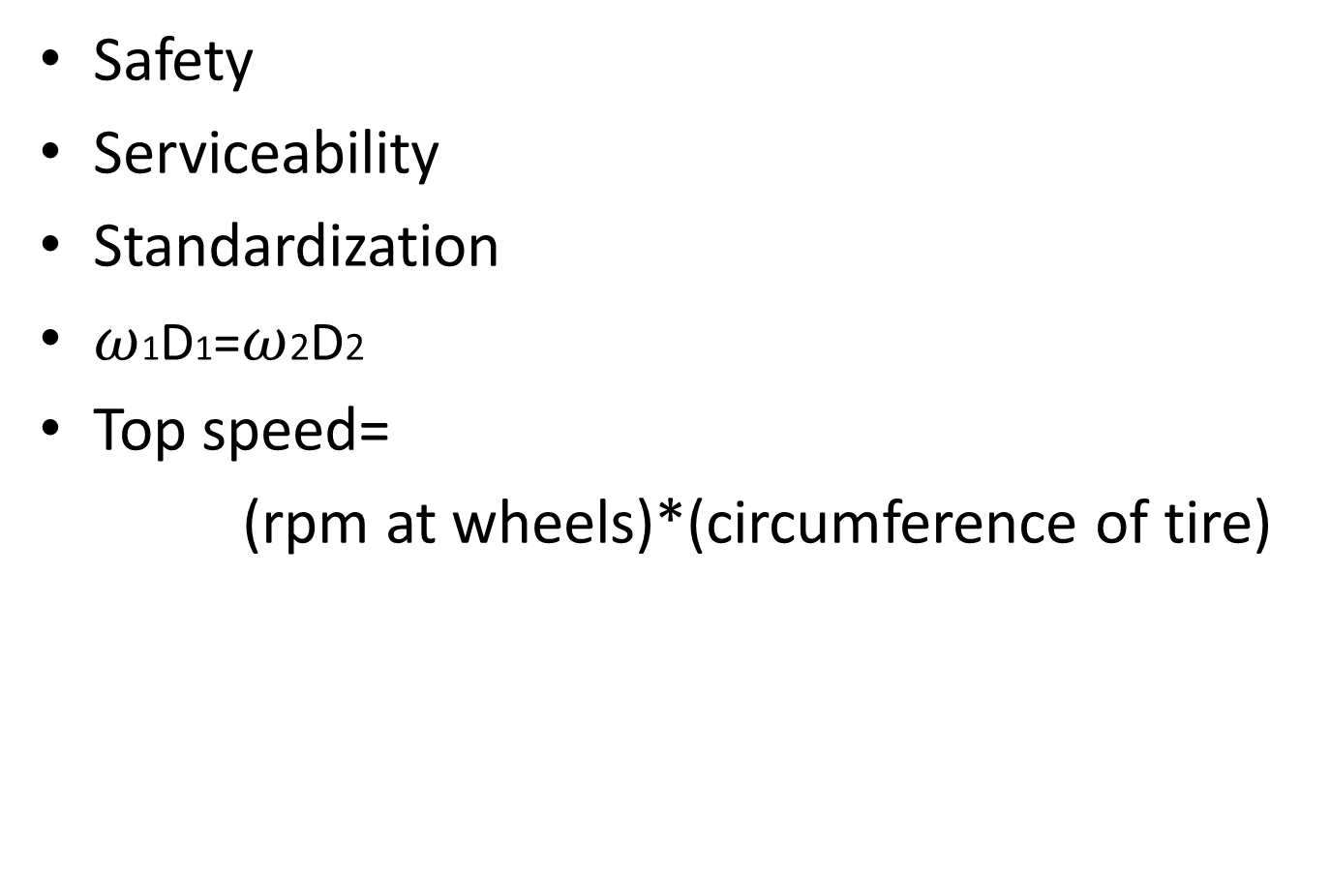
Design Methodology
Safety
Serviceability
Standardization
$ω$1D1=$ω$2D2
Top speed=
(rpm at wheels)*(circumference of tire)

Slide 41
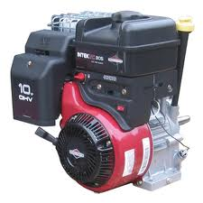

Engine Specification
Engine: Briggs & Stratton ,10 HP,305 cc
Description | Value
Maximum rpm | 3800
Maximum torque | 18 N.M
Maximum power | 10 HP

Slide 42
CVT
CVT is purchased from CVTECH.
Description | Driver | Driven
Inner radius | 27.12mm | 21.4mm
Outer radius | 192.5mm | 198mm
Description | Values
Min.Ratio | 3:1
Max Ratio | 0.43:1
Efficiency | 93%
Engagement rpm | 2600
C-C distance | 242mm

Slide 43
FNR GEAR BOX
Position | Ratio
Forward | 18:1
Neutral | 0
Reverse | 36:1
FINAL DRIVE TRAIN VALUES
Discription | Value
Over all reduction ratio | 7.7:1
Tire diameter | 25 inch
Max speed | 58 kmph
Max acceleration | 4 m/s2
Output torque | 11 n.m
Traction force | 311.3 n

Slide 44
Gear box drive shaft wheels.
Exhaust system will contain a catalytic converter and a muffler.
CO₂ absorber will be connected to exhaust output.

Slide 45
ELECTRICAL SYSTEM

Slide 46
Electrical System
The goal of the electrical system is to wire up the key safety components such as the kill switches, brake light, reverse alarm and light and braking by solenoid.
Apart from that it aids the driver through the instrumentation panel which consists of the speedometer, fuel indicator and the brake fluid level indicator. It is also used for the lighting system of the car.
The entire power for d electrical system is derived from a 12V battery which will be charged by the onboard alternator.
Whole wiring will be done by 16 gauge electrical wire in red and black.

Slide 47
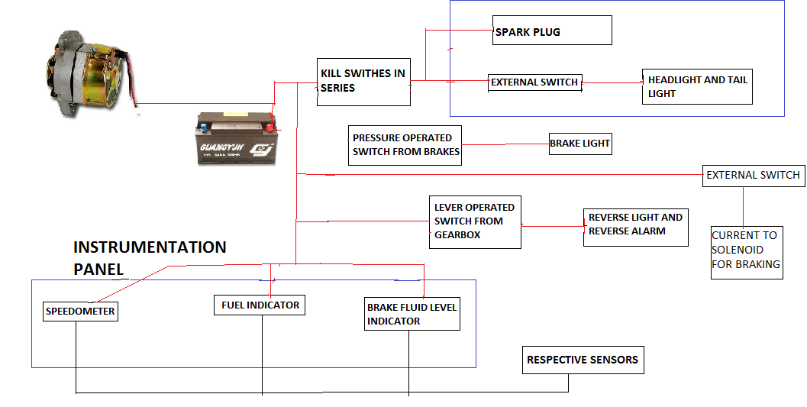
Layout

Slide 48
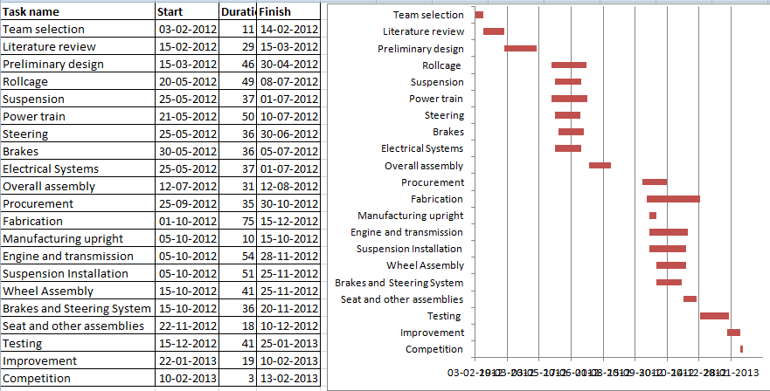
Project Plan

Slide 49
Post-Fab. Design Validation Plan

